Slide 1



Master Thesis Defense
Design and Control of a Ball and Plate Didactic Device
Author : Jihad Alsamarji
Supervisor : Prof. Dr. Ir. Micheal Kinnaert
Ir. Laurent Catoire
Co-supervisor : Dr. Ir. Christoph Mertens

Slide 2

Control Theory
Notes:
Control system design is one of the hardest courses taught in engineering.
It has myriad of applications in mechanical,electrical,biomedical and many other disciplines.
One of the reasons why this course is hard for some students is that this sector contains so much maths which is abstract.

Slide 3
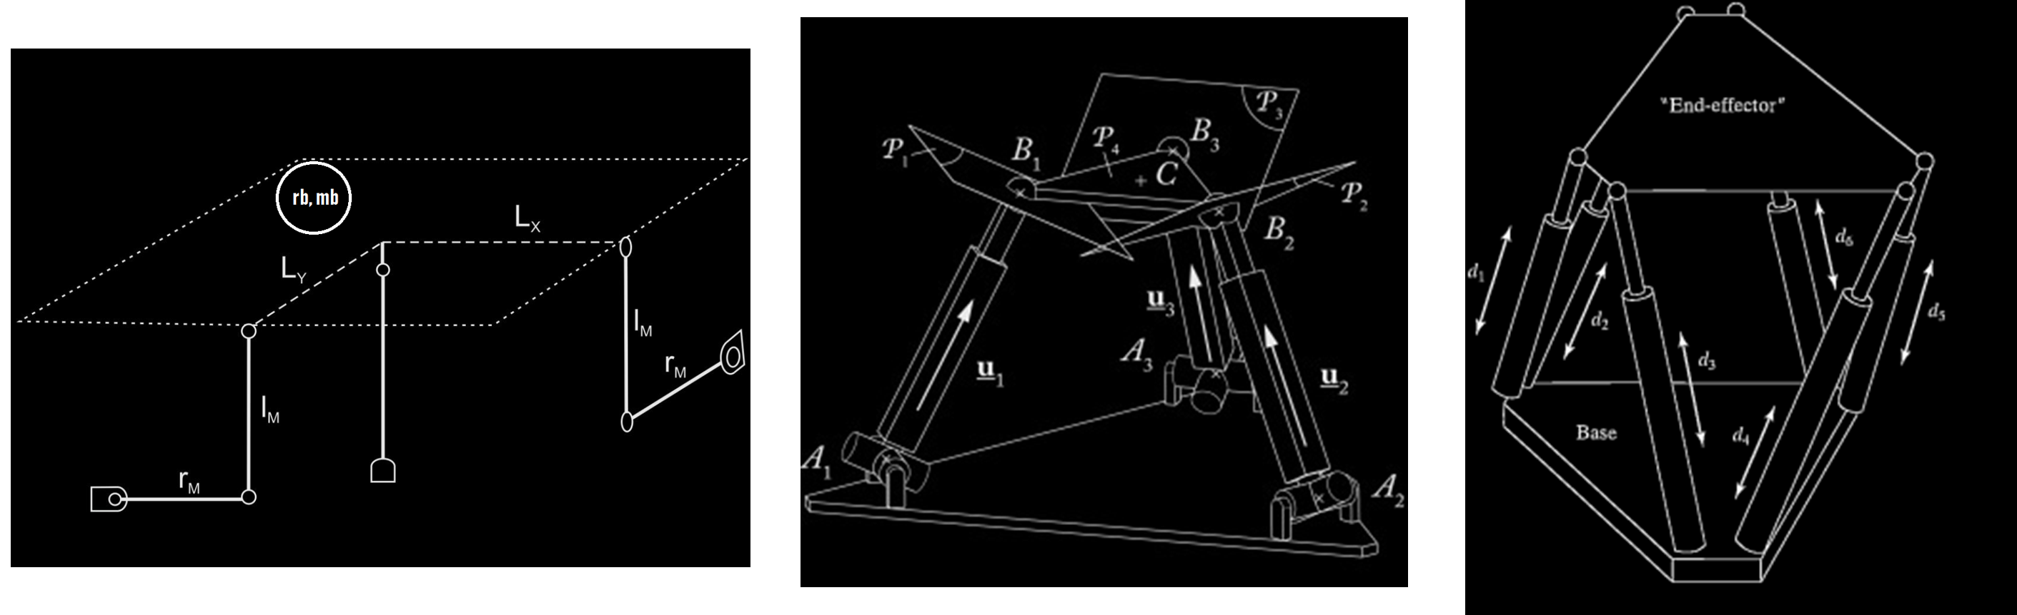
Plant Selection
- Portable
- Safe
- Affordable
- Controllable
- Scalable
- Convenient
2DOF
3DOF
6DOF
Notes:
Control system design is one of the hardest courses taught in engineering.
It has myriad of applications in mechanical,electrical,biomedical and many other disciplines.
One of the reasons why this course is hard for some students is that this sector contains so much maths which is abstract.

Slide 4
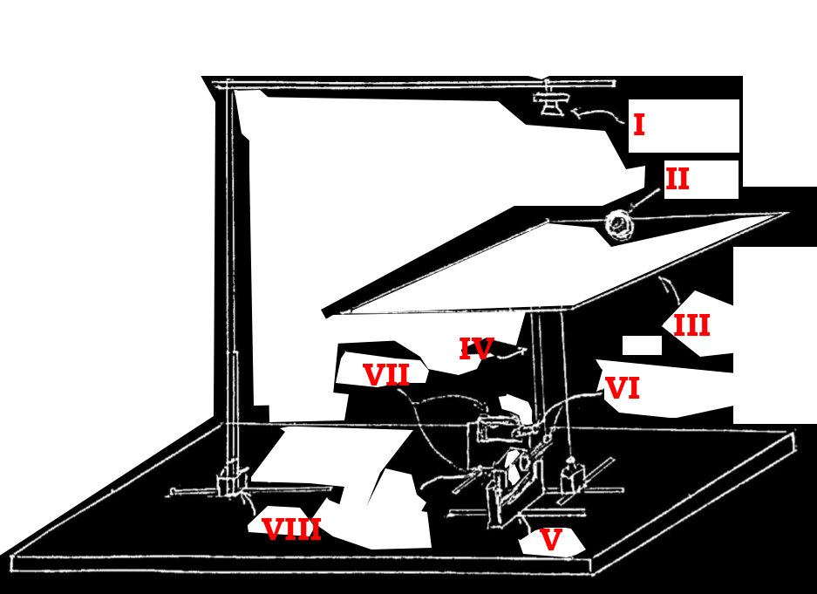
Conceptual Design
Sensor
Actuator
Processing Unit
Camera
Resistive Touchscreen
Step Motor
Servo Motor
Arduino
RasberryPi
Custom Made PCB
Computer
Notes:
Control system design is one of the hardest courses taught in engineering.
It has myriad of applications in mechanical,electrical,biomedical and many other disciplines.
One of the reasons why this course is hard for some students is that this sector contains so much maths which is abstract.

Slide 5
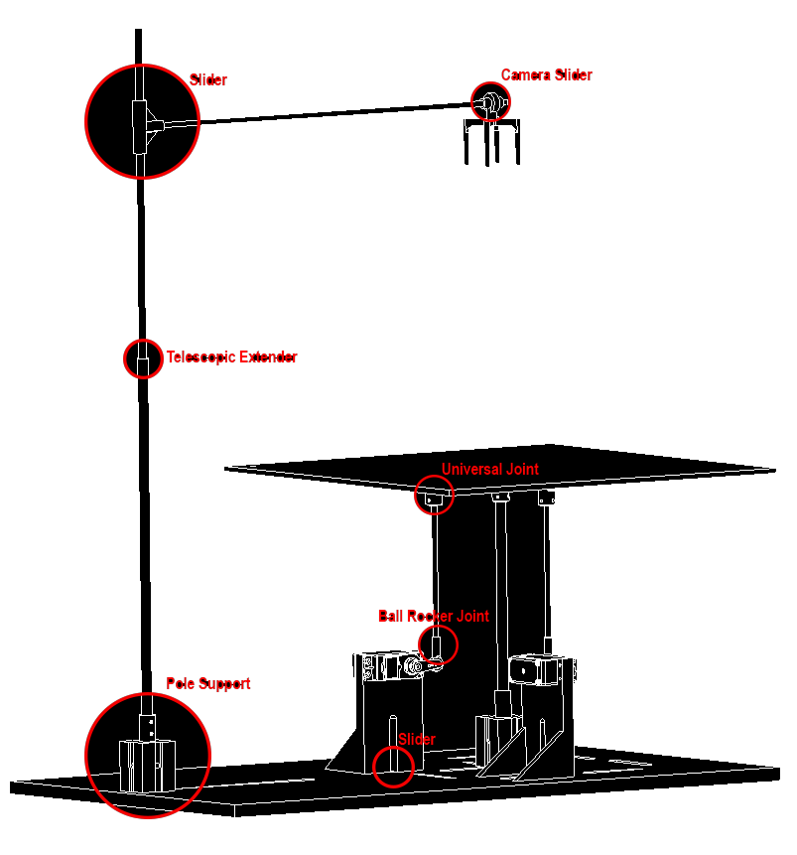
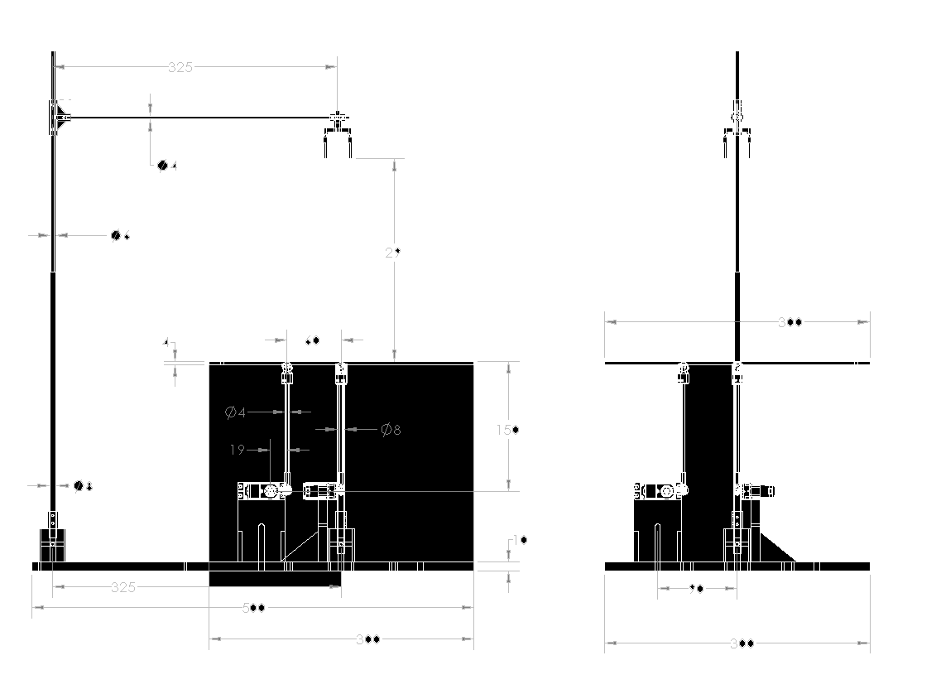
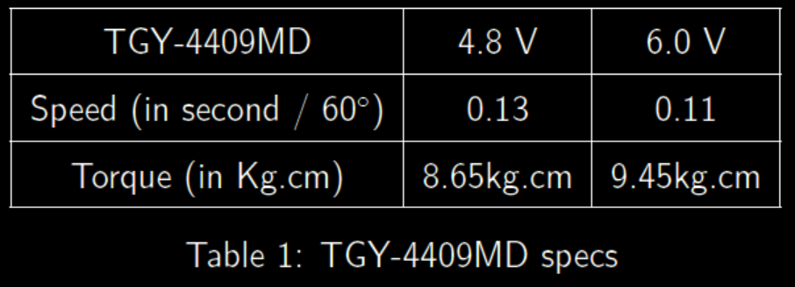
Mechanical Design
Size of the actuated plate (30x30cm)
Height of the actuated plate (27cm)
Size of the supporting bench (50x30cm)
Size of the servo frame (Standard Size)
Material for plate and bench (4mm Plywood)
Material for actuating rods and Camera Support (Carbon fiber)
Material for Supporting structure (PLA)
Using a ball of 0.1 [Kg]
Assuming a critical situation that the plate is handled by one servo motor.
A customizability factor of 2 is used.
A factor of 10 is used to ensure operation in the continuous region.
Required torque is roughly speaking 8.4 [Kg.cm]
Connection between Rods and Servo Arm (Rod End Bearing or Rocker Ball Joint)
Connection between Rods and Plate (Universal Joint or Magnetic Ball Joint)
Ratio K = dc / dm
Flexibility and customization using slideways.
Accuracy and Response Speed

Slide 6
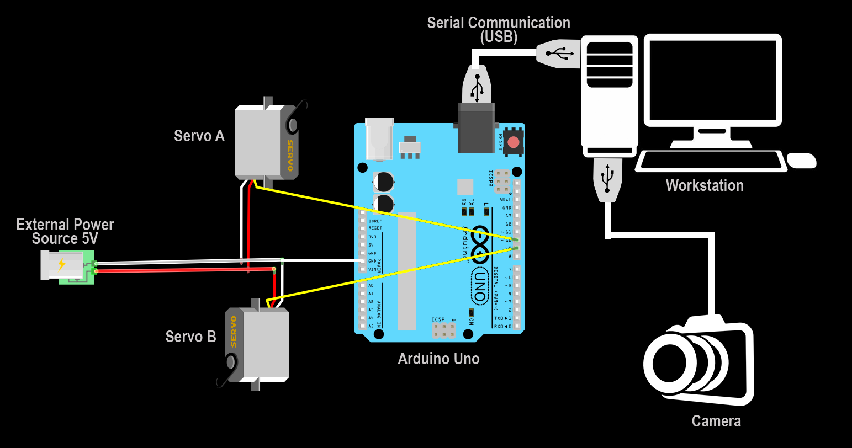
Electrical Design

Slide 7
Modelling

Slide 8
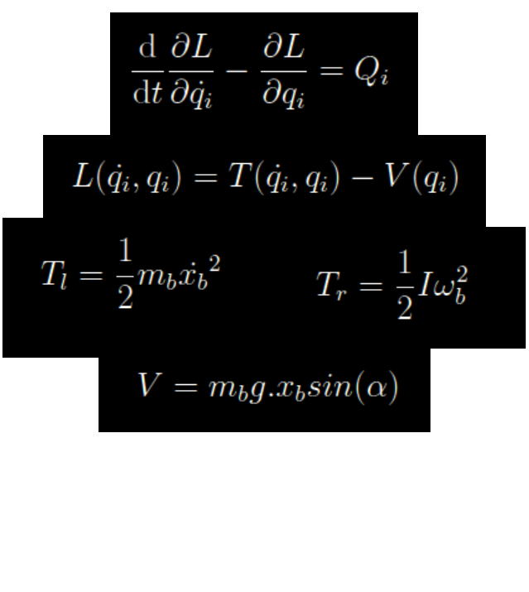
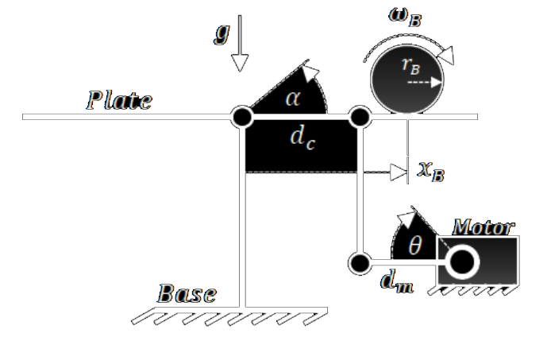
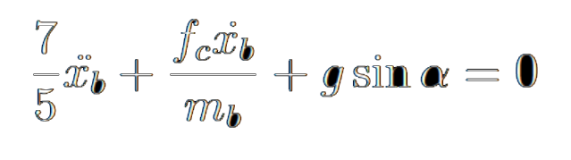
System Dynamics Modelling
Equation of motion of the Ball Obtained By LaGrange formulation :

Slide 9
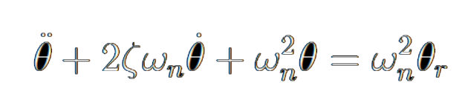
System Dynamics Modelling
Equation of motion of the Servo motor obtained by second order assumption :

Slide 10
System Dynamics Modelling
Need a third equation to link Alpha to Theta !

Slide 11
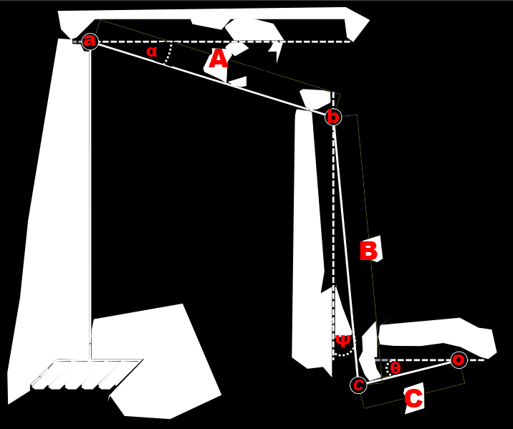
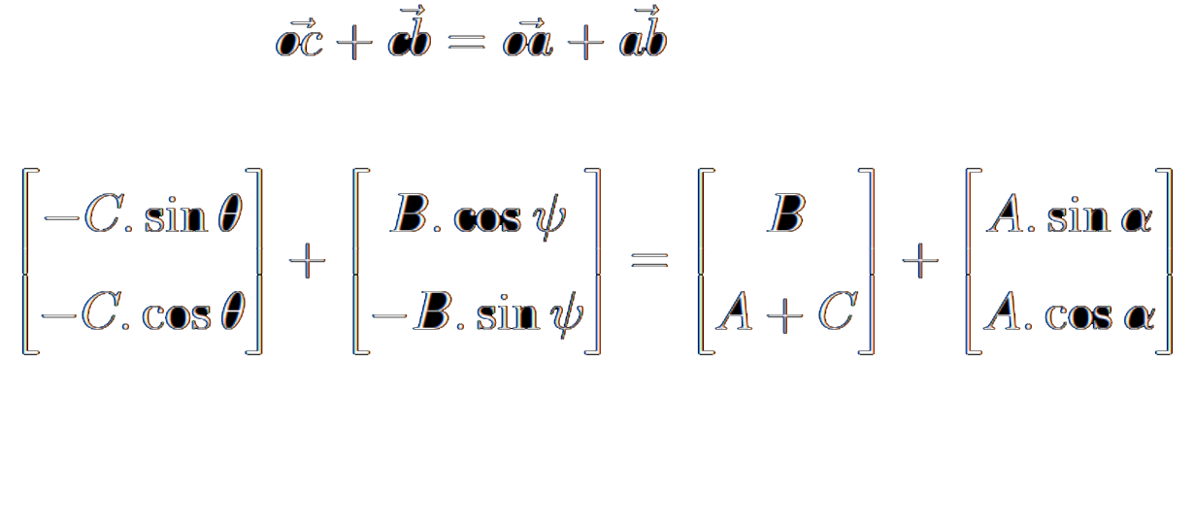
System Dynamics Modelling

Slide 12
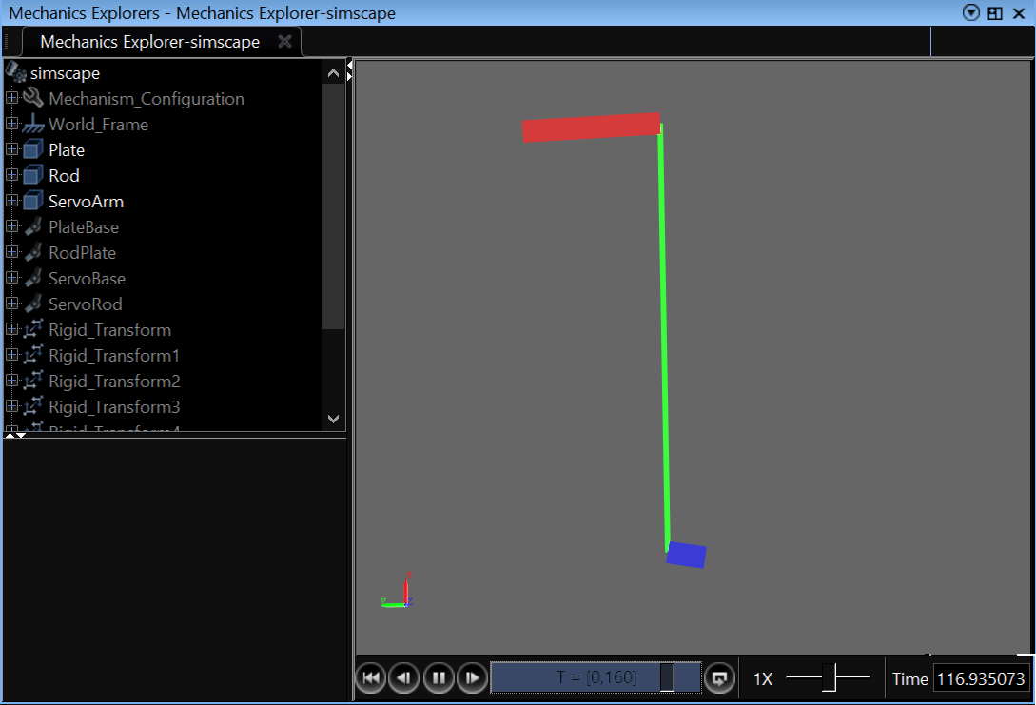
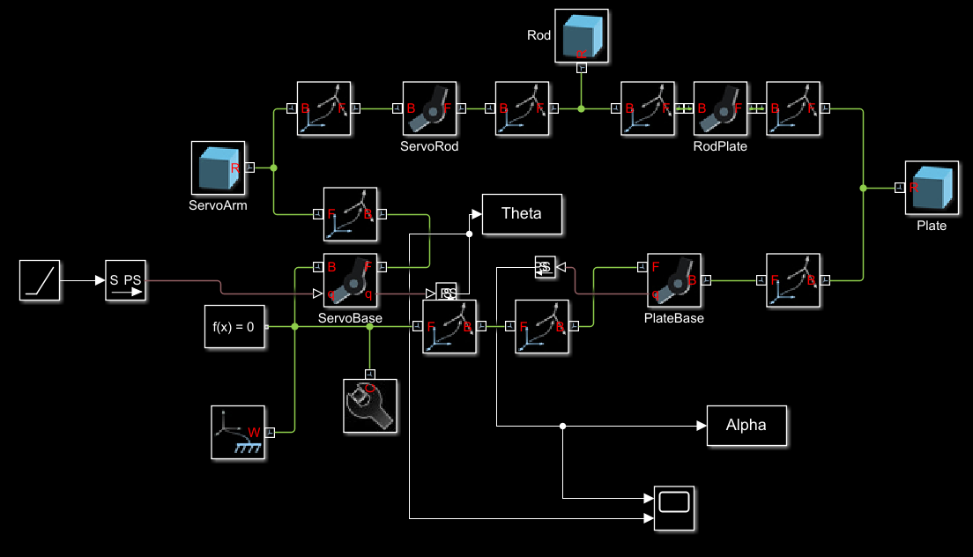
System Dynamics Modelling

Slide 13
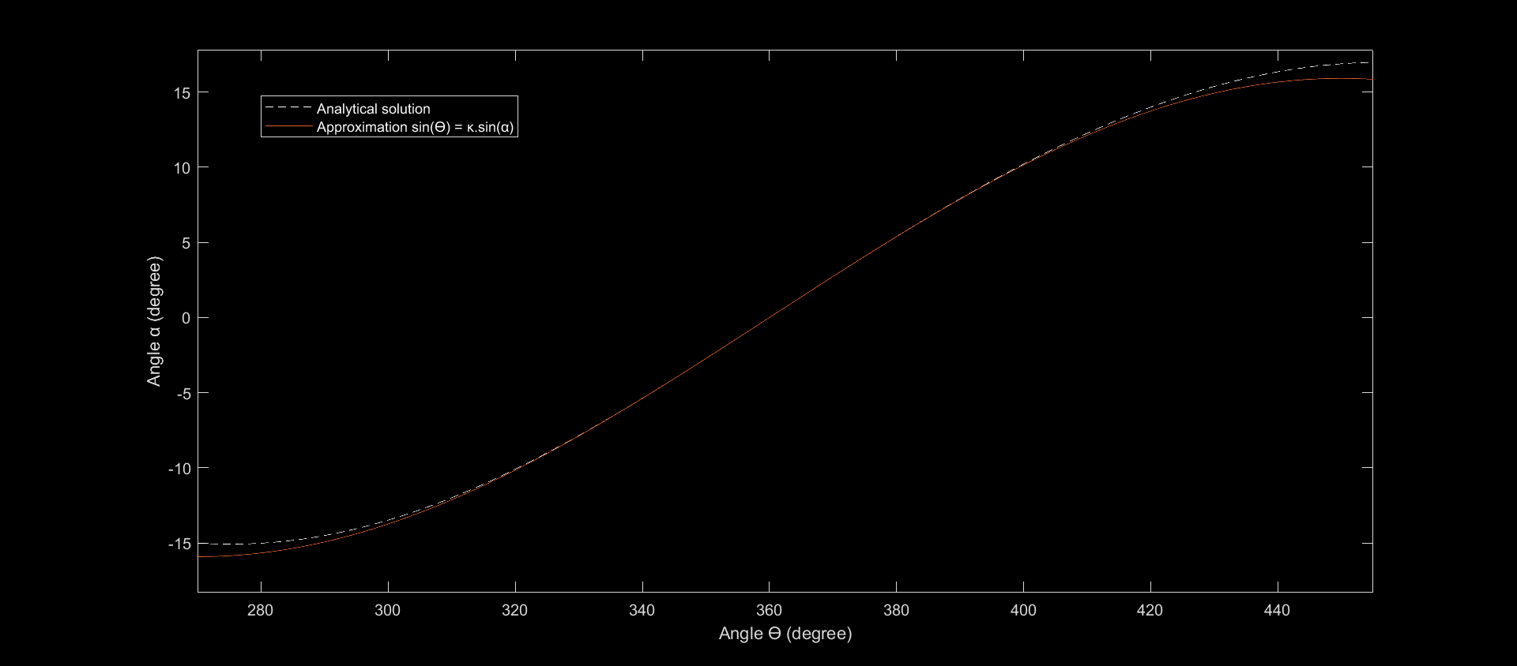
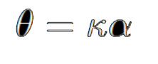
System Dynamics Modelling
Numerical
Ratio K = A / C

Slide 14
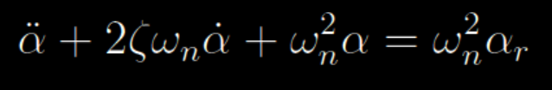
System Dynamics Modelling
Determine parameters by identification !

Slide 15
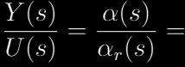
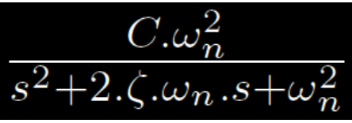
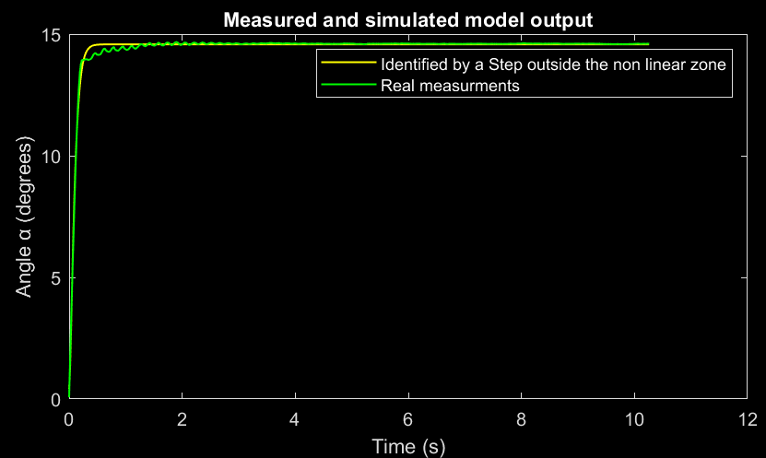
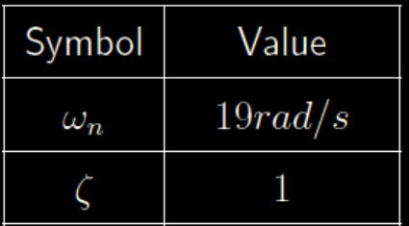
System Identification : Servo Motor Dynamics

Slide 16
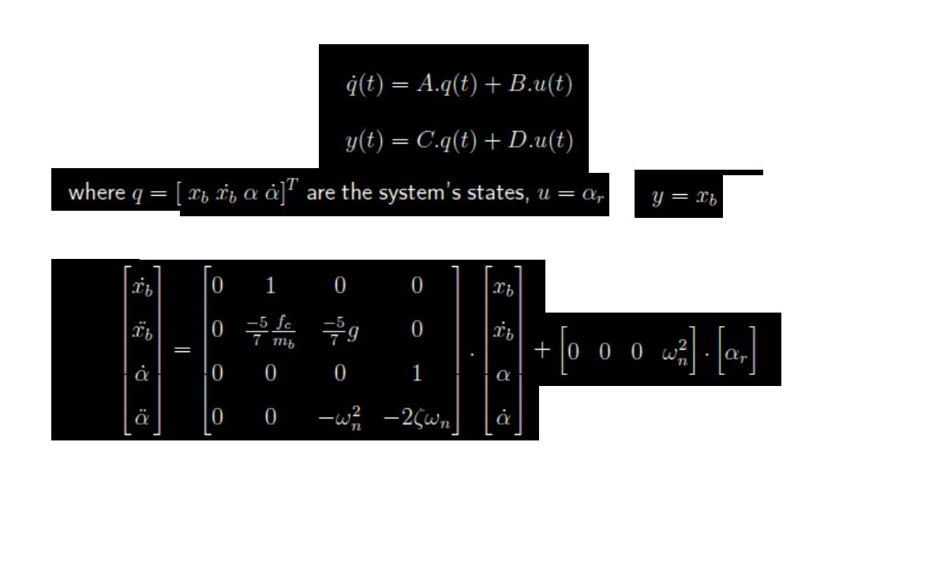
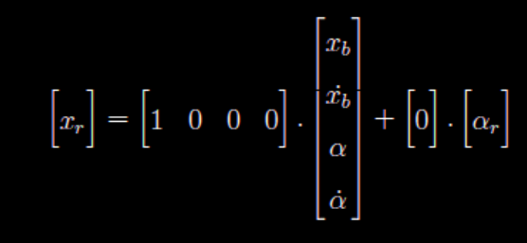
LTI State Space Model

Slide 17
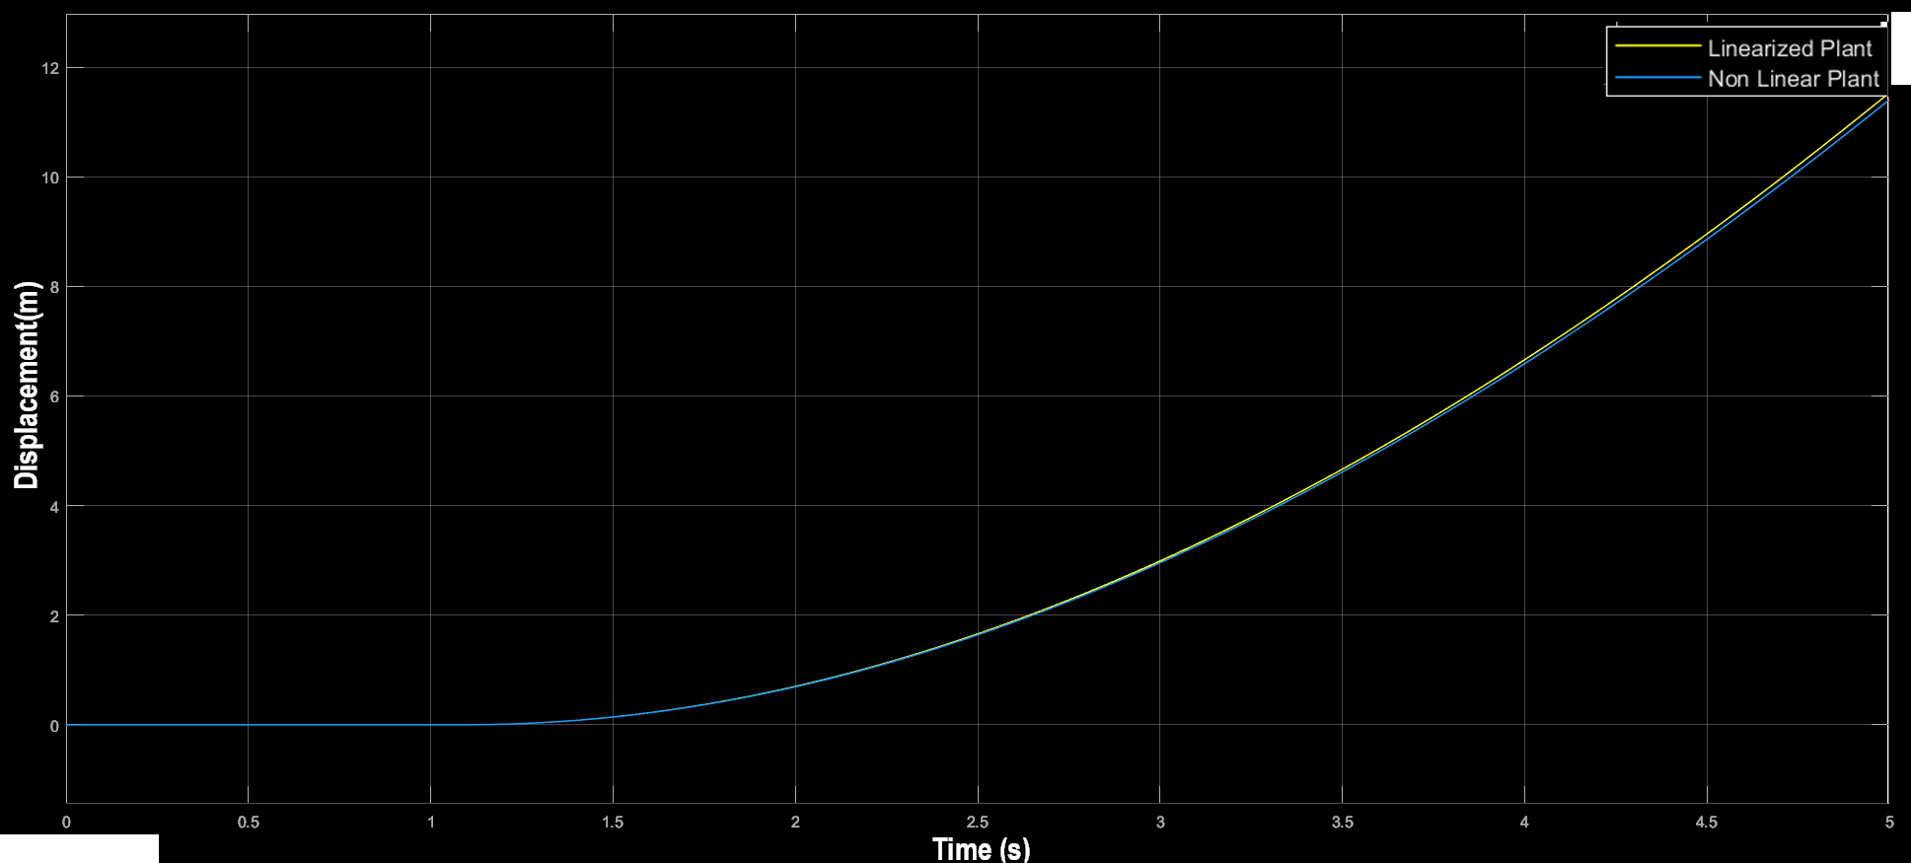
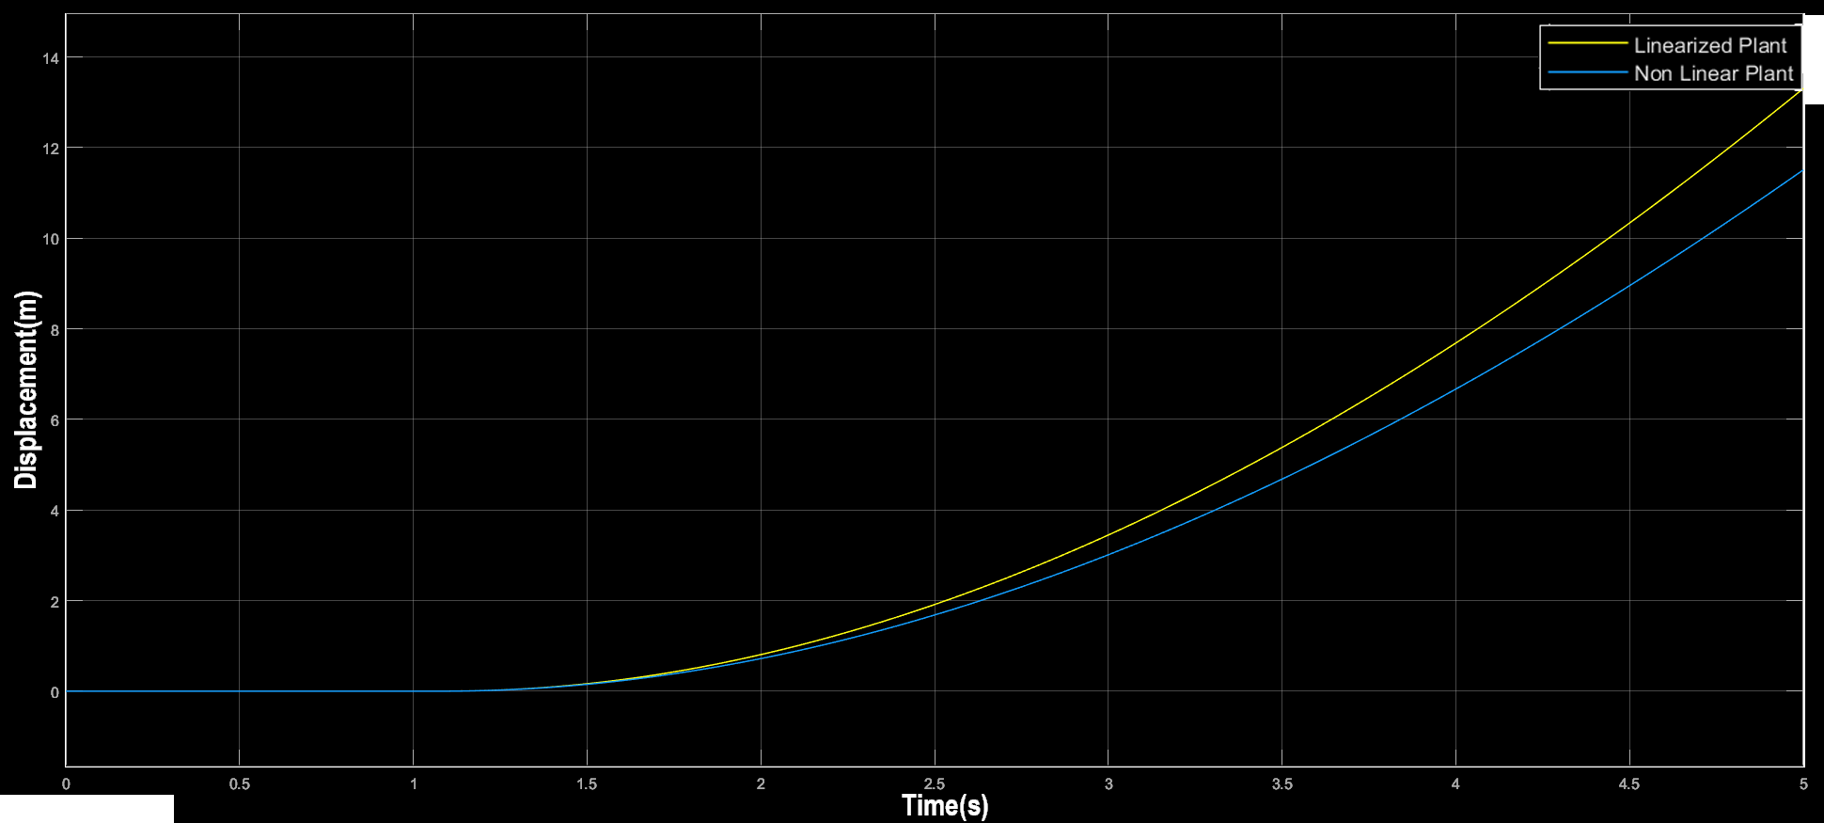
System Dynamics Modelling
Alpha < 15
Alpha > 15

Slide 18
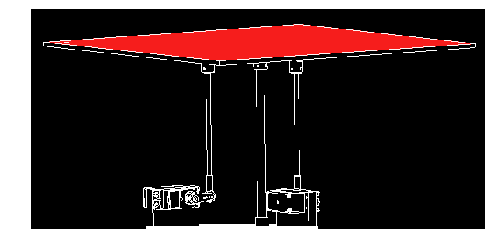
LTI State Space Model
Not BIBO Stable
Interesting to check
Controllable
- States of equilibrium
- Stability analysis
- Controllability Analysis
- Observability Analysis
Observable

Slide 19
Control Design

Slide 20
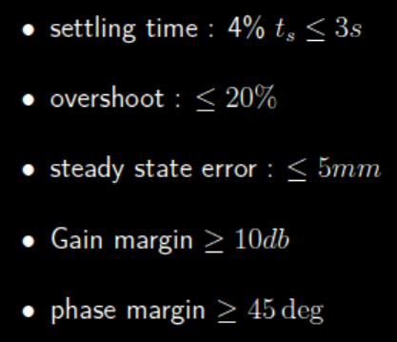
Control Requirements
Pole Placement
Loop shaping

Slide 21
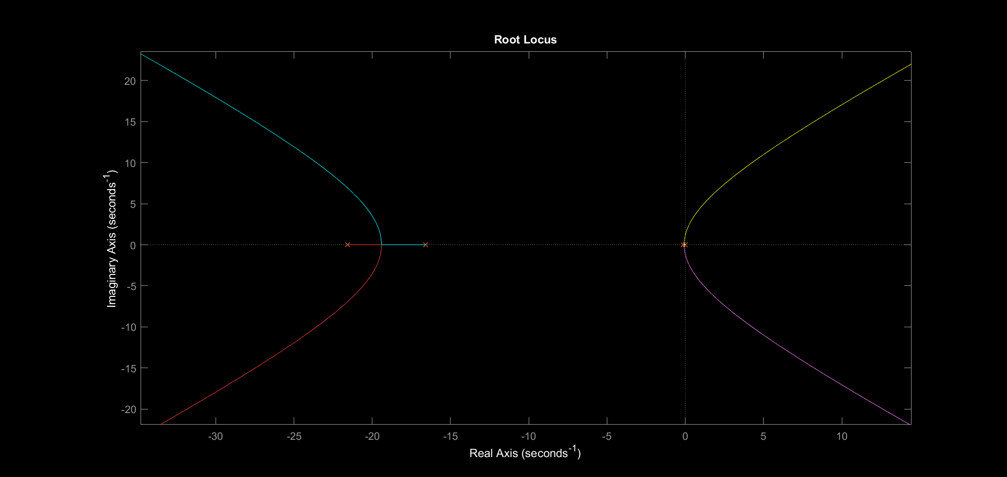
Root Locus with No Controller

Slide 22
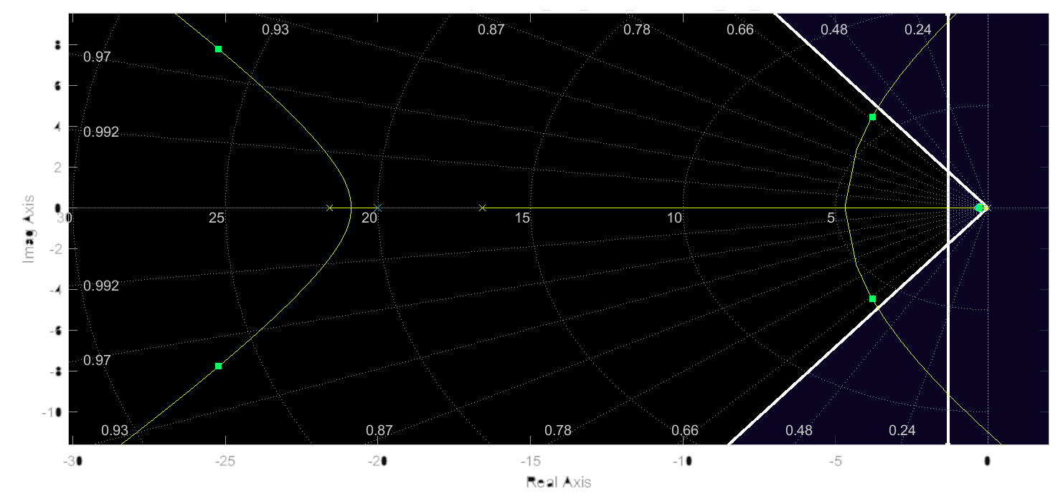
Root Locus with ( PD with low pass filter)

Slide 23
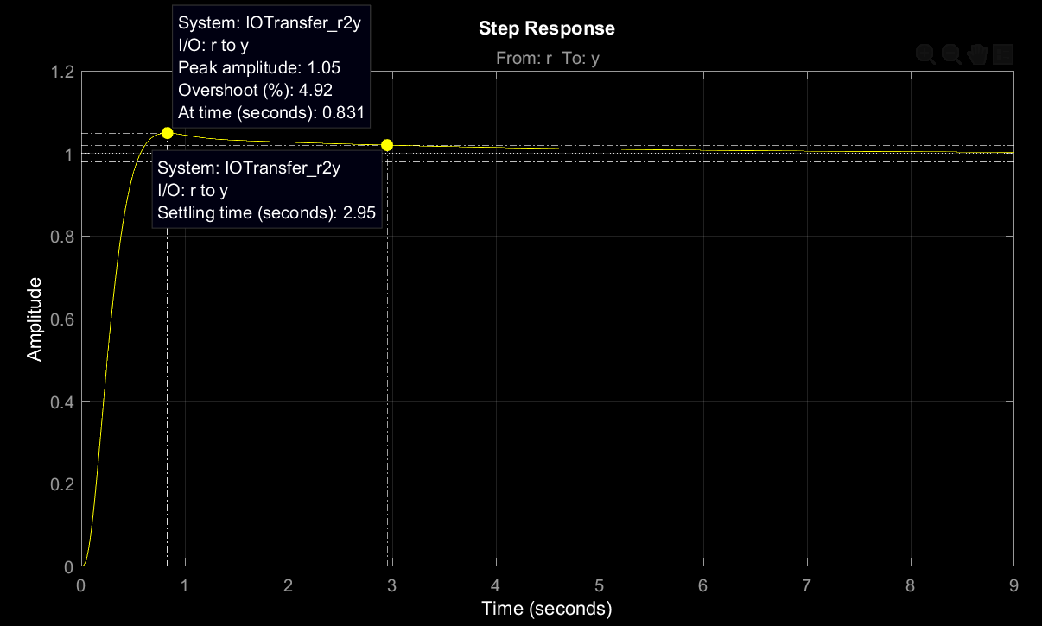
Step Response with ( PD with low pass filter)

Slide 24
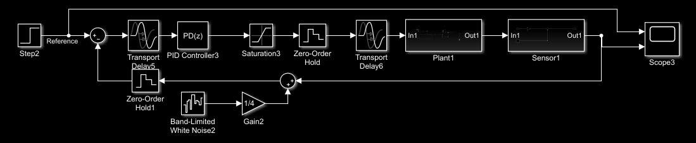
Discrete Simulink Model

Slide 25
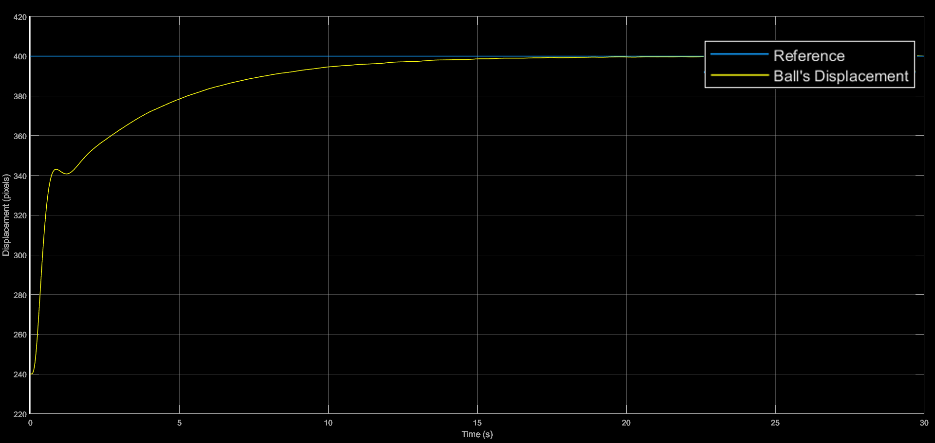
Step Response on Discrete Simulink Model

Slide 26
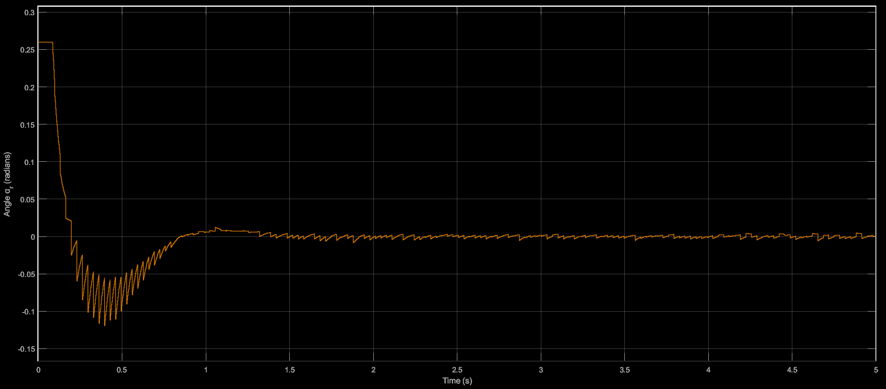
Controller Saturation

Slide 27
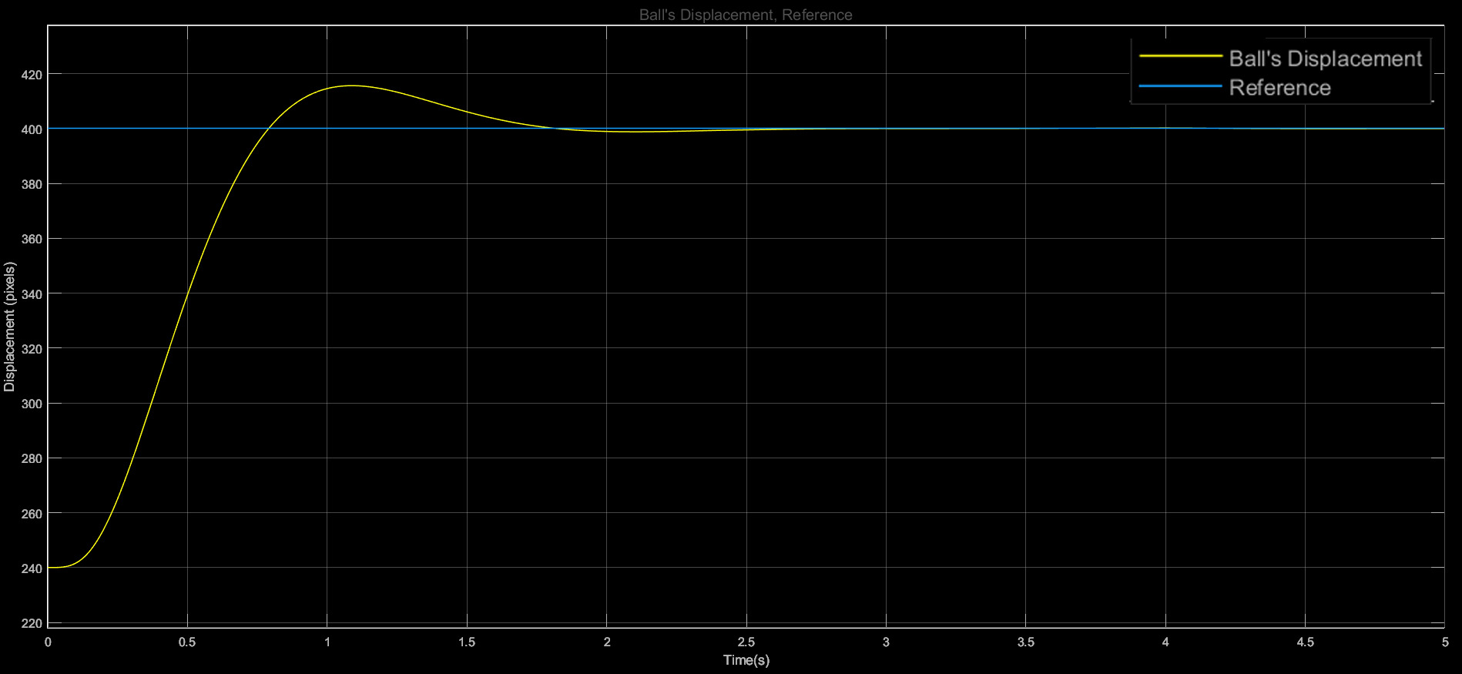
Step Response on Discrete Simulink Model

Slide 28
Validation

Slide 29
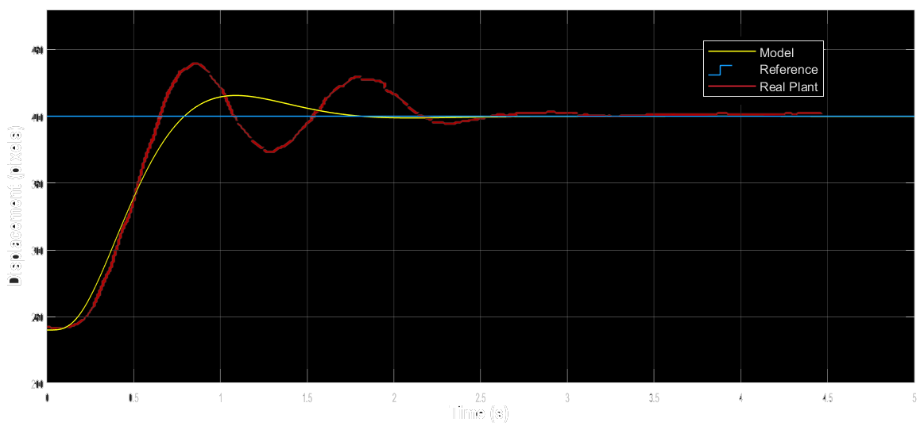
Step Response Validation

Slide 30
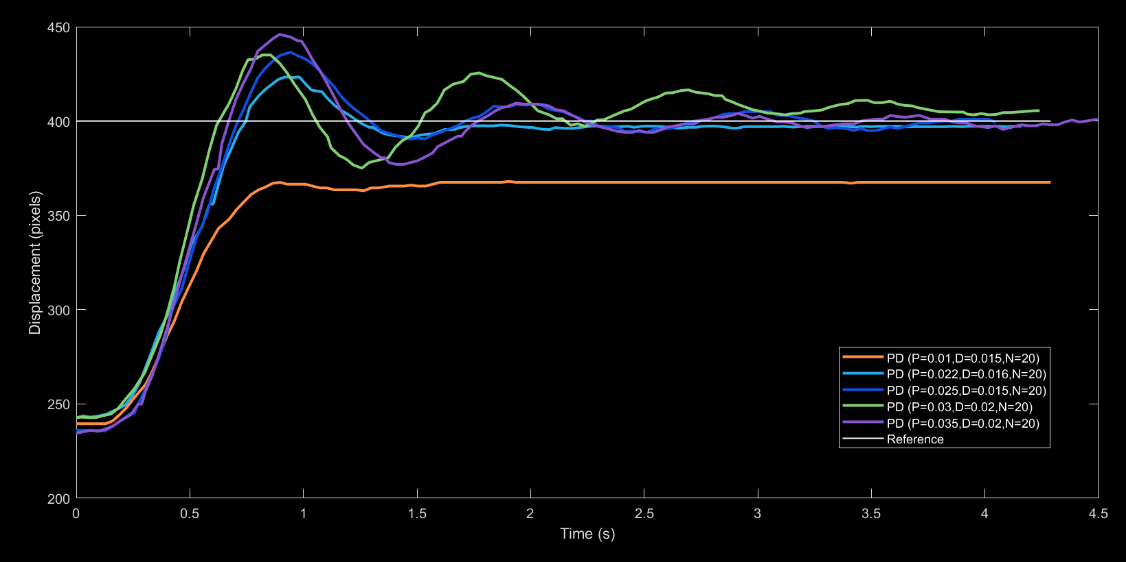
Different PD Controllers Comparison

Slide 31
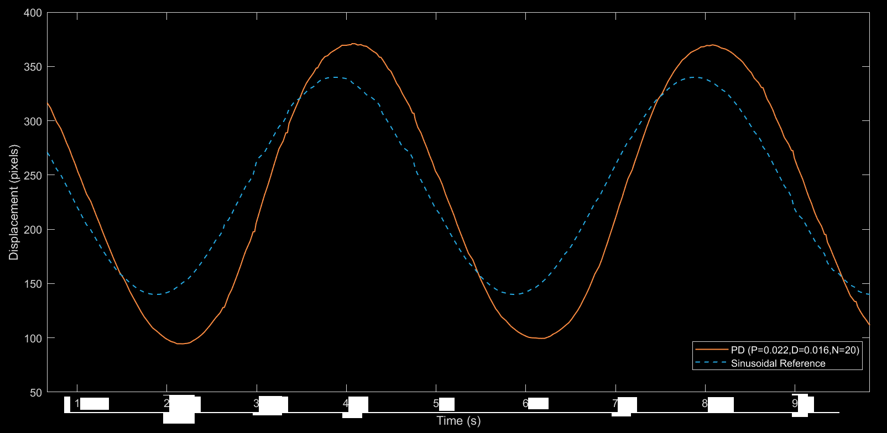
Sinusoidal Reference

Slide 32
Implementation

Slide 33
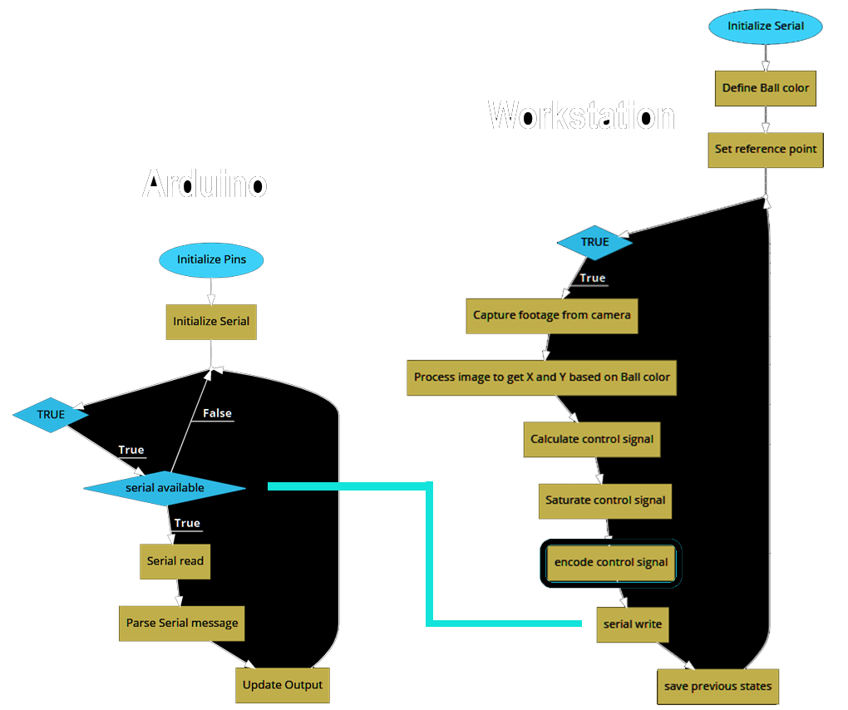
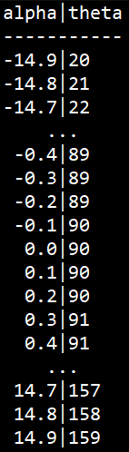
Software Design
Lookup Table

Slide 34
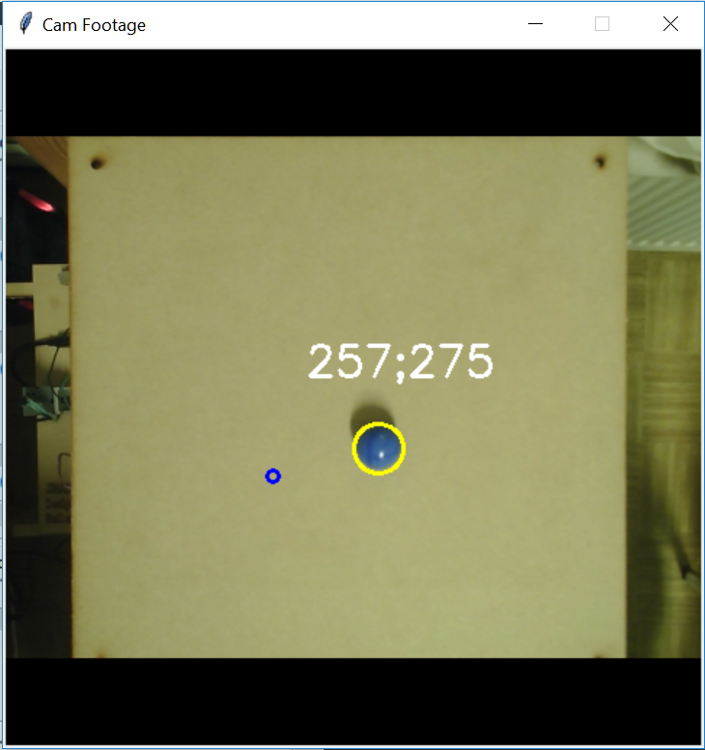
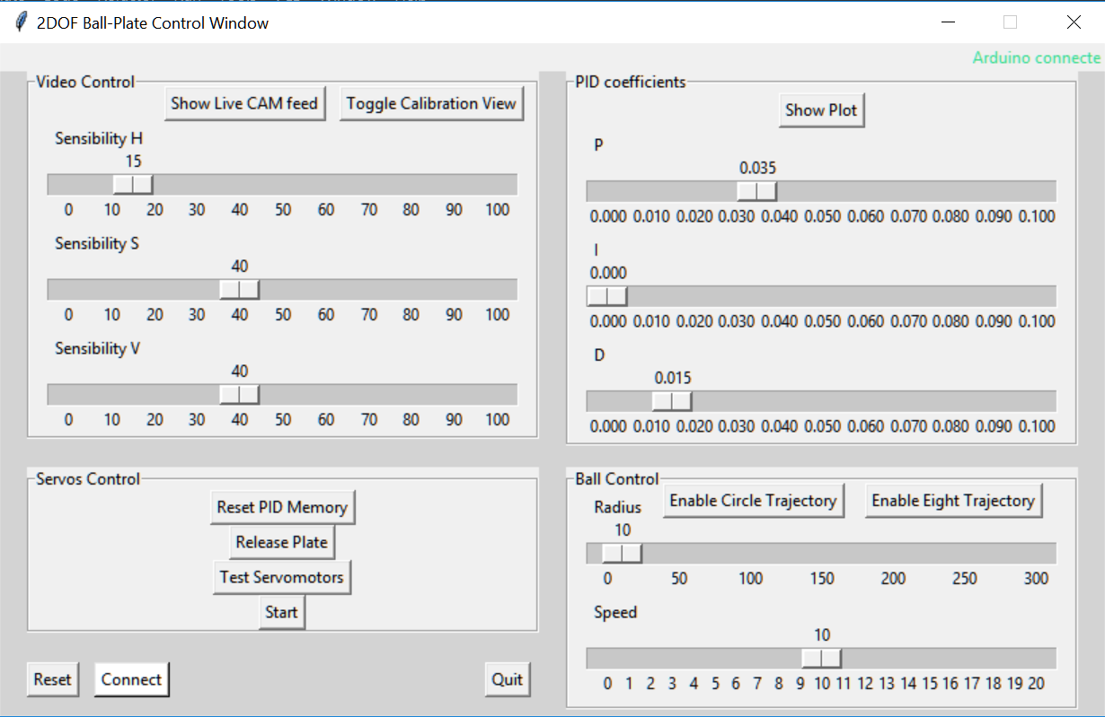
Software Design
Notes:
The lookup table is to map between the angle theta and alpha since the relation between them is non linear and we don’t want to solve for it analytically each cycle

Slide 35
Conclusion

Slide 36
Achievements
Problems
Solutions
Hardware Selection
Mechanical Design
Electrical Design
Software Design (GUI)
Modeling and Identification
Controller Design (PD)
Simulation and Validation
Functioning Plant
Bad Servo Accuracy
Bad Servo Response Speed
Structural Vibration
Joint Play → Vibrations
Derivative Vibrations
Inaccurate Assembly
Servo Motor Change
Redesign Support Structure for more damping
Joint Replacement
Filtering Derivative
Use of Alignment tools for Assembly
Future Improvements
Implementing Advanced controllers in the GUI
Optimizing the structure
Fully Utilize the Camera (60FPS)
Unification by RasberryPI

Slide 37
Video Demo

Slide 38
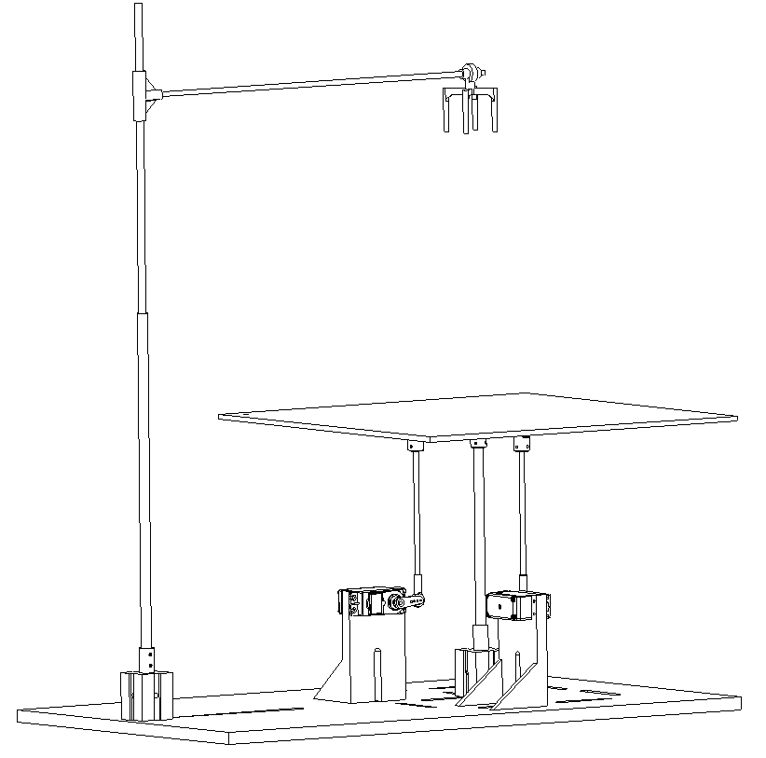
Thank You For Your Attention
Questions ?

